Slide 1

The Global Impact of Data Science
(An in-depth look into the world of data science)
Dashboard using R
-By Nishna Paria (A048) &
Anshika Sharma (A061)

Slide 2

Introduction to Data Science
Multidisciplinary Field
Extracting knowledge and insights from
structured and unstructured data
Combines expertise from various domains
Impacts various industries and has a
signiﬁcant global presence
Goal is to transform raw data into actionable
insights

Slide 3

Importance of Data Science
Data science empowers organizations with the ability to make well-informed decisions.
Data Science is the key to extracting valuable insights from vast and complex datasets. By leveraging advanced analytical techniques, organizations can gain a deeper understanding of their data, leading to informed decision-making.
Unlocking Insights from Data
Driving Innovation
Enhancing Decision-Making
Solving Complex Problems
Increasing Efficiency

Slide 4

Application of Data Science
1. Healthcare:
Predictive Analytics and Personalized Medicine
2. Finance:
Fraud Detection and Risk Management
3. Marketing:
Customer Segmentation and Recommendation Systems
4. Retail:
Demand Forecasting and Price Optimization
5. Telecommunications:
Network Optimization and Predictive Maintenance

Slide 5

Salaries in Data Science
Professionals in data science command competitive salaries due to the high demand for their expertise.
Roles such as data scientist, data analyst, and machine learning engineer are among the top-paying positions globally. Salaries in Data Science can vary widely based on factors such as experience, location, education, and the specific industry or company.
Roles in the field of Data Science:
Data Analyst
Data Scientist
Data Engineer
Big Data Engineer
Chief Data Scientist or Director of Data Science
Business Intelligence (BI) Analyst
Machine Learning Engineer
Artificial Intelligence (AI) Engineer
and many more…

Slide 6
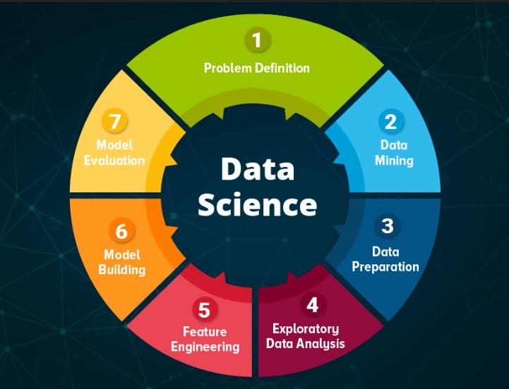
Factors Influencing Salaries
Experience: More experience often correlates with higher salaries.
Education: Advanced degrees can command higher compensation.
Location: Salaries are impacted by the cost of living in a particular area.
Industry and Company Size: Larger companies and certain industries may offer higher salaries.
Skills and Certifications: Specialized skills and relevant certifications can increase earning potential.

Slide 7

Challenges in Data Science
Data privacy, ethical considerations, and the need for continuous skill development pose challenges in the ﬁeld of data science. Overcoming these hurdles is essential for sustainable growth and ethical data practices.
1.Data Quality and Cleaning
2.Data Privacy and Security
3. Lack of Domain Expertise
4. Model Overfitting
5. Ethical Concerns

Slide 8

The Future of Data Science
The future of data science holds immense potential for automation, AI integration, and advanced analytics. It will continue to evolve, shaping the future of technology, business, and society at large. It is expected to be dynamic and transformative, driven by advancements in technology, the increasing volume of data, and the evolving needs of various industries.
Artificial Intelligence (AI) Integration
Automated Machine Learning (AutoML)
Edge Computing in Data Science
Data Ethics and Privacy
Continuous Learning and Skill Evolution
Augmented Analytics
Quantum Computing
Data Governance and Quality
Climate and Environmental Data Science

Slide 9
Conclusion: Impact of Data Science
Data science has a global impact
Signiﬁcance will continue to grow, inﬂuencing the future
Impact not limited to the business sector
Data science methodologies contribute to groundbreaking discoveries
Data science has ushered in a new era of innovation, efficiency, and informed decision-making

